Slide 1
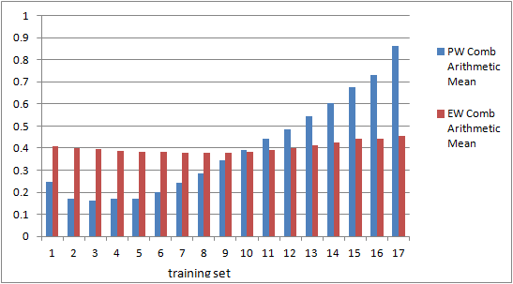
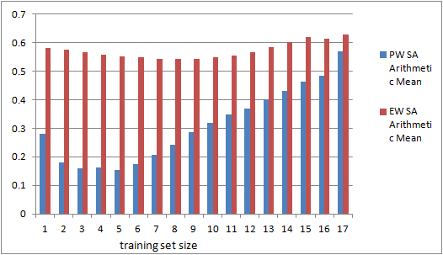
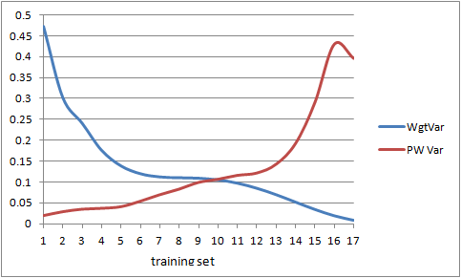
1.Raveem GeoPolitRisk
Out-of-Sample Combined Score on Test Set
As function of Training Set Size
(averaged over all sets of given size)
Out-of-Sample Statistical Accuracy Score on Test Set
As function of Training Set Size
(averaged over all sets of given size)
Wgt’d Variance of Expert norml’zd weights (in-sample)
Ave Variance of PW combined score (out-of-sample)

Slide 2
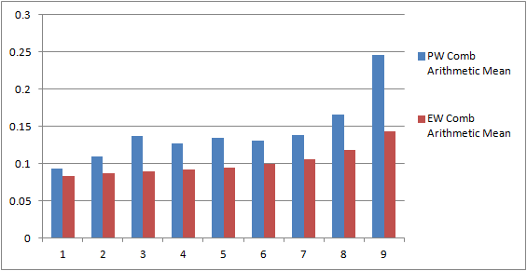
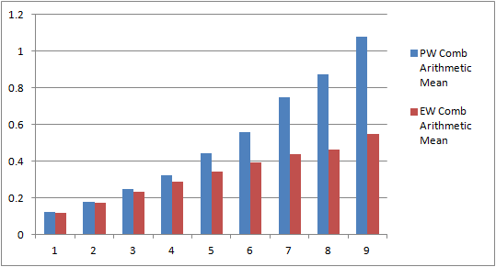
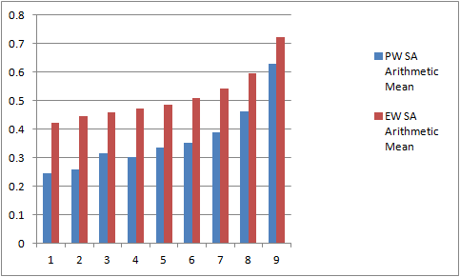
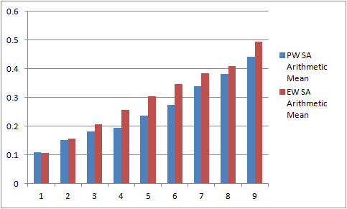
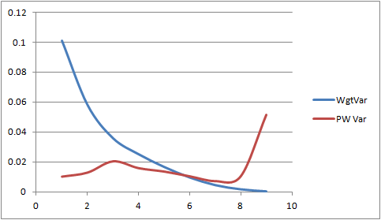
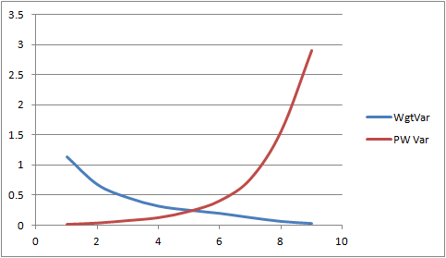
2. Arkansas 3. Arsenic PW = BE
3

Slide 3
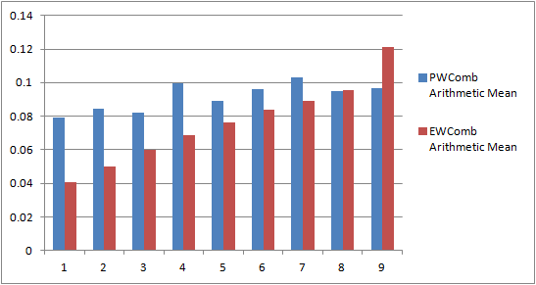
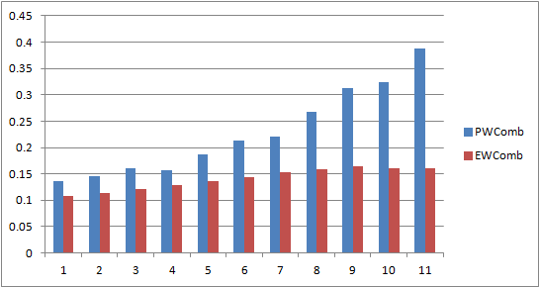
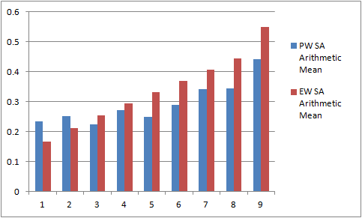
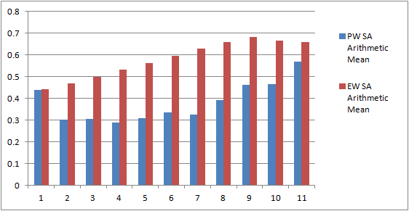
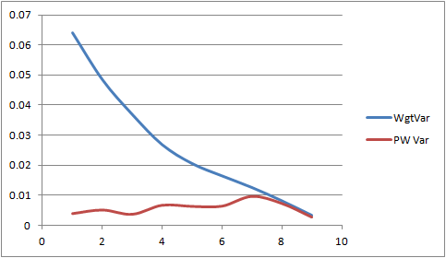
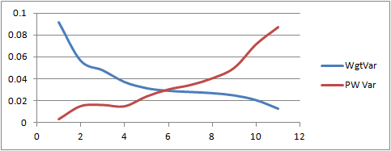
4. ATCEP 5. Biol agents

Slide 4
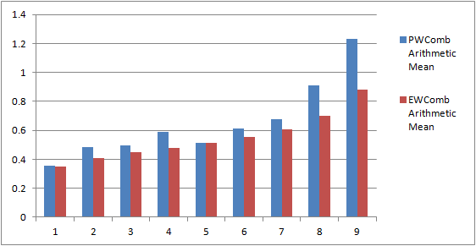
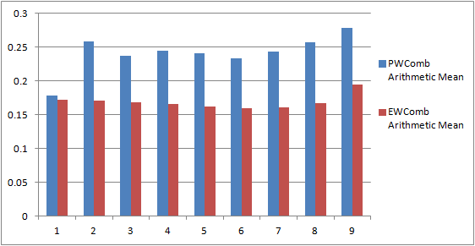
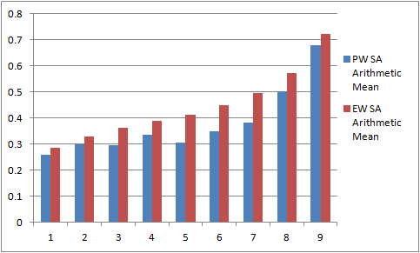
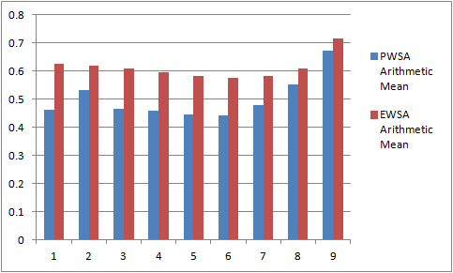
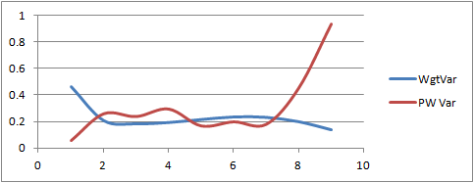
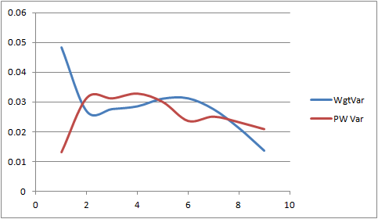
6. CDC ROI PW=BE 7.Covering Kids

Slide 5
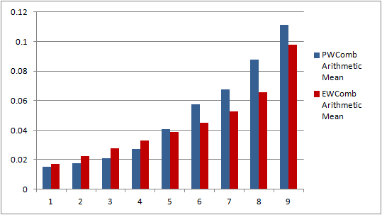
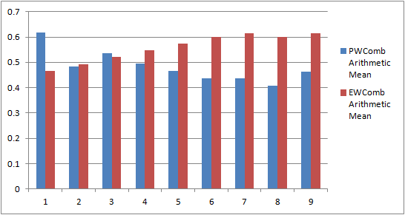
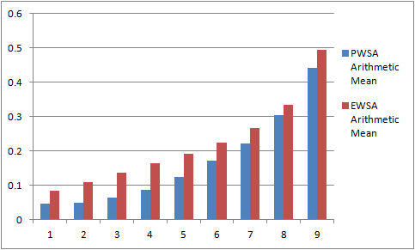
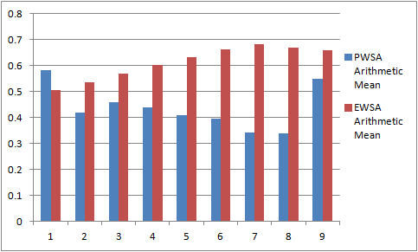
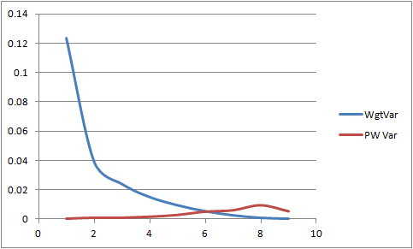
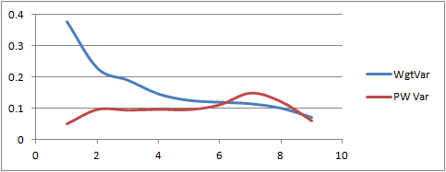
8. Create 9. CWD

Slide 6
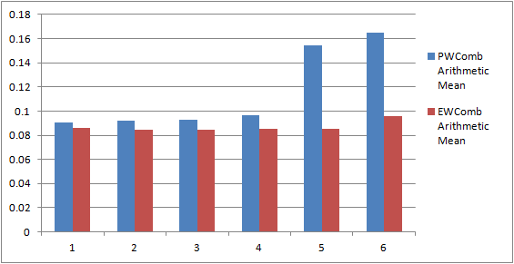
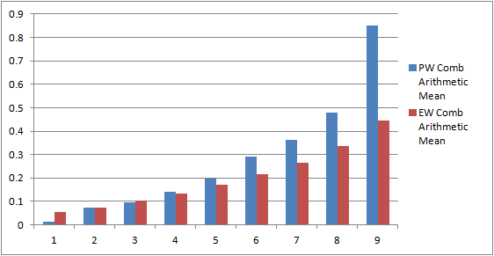
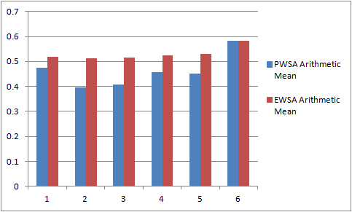
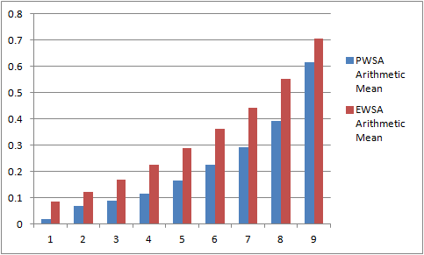
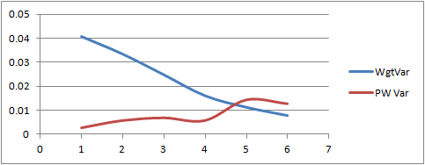
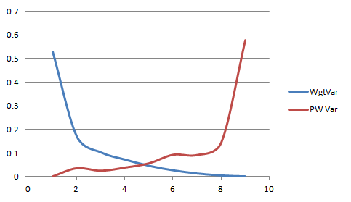
10. Daniela PW=BE 11. DCPN Fistula

Slide 7
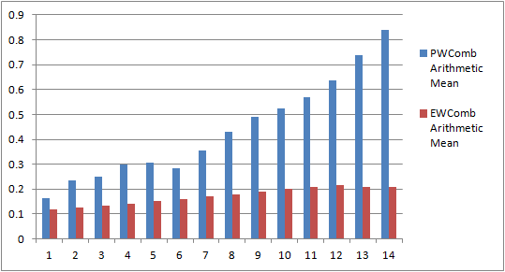
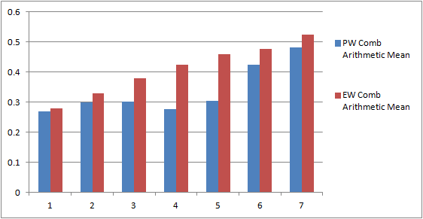
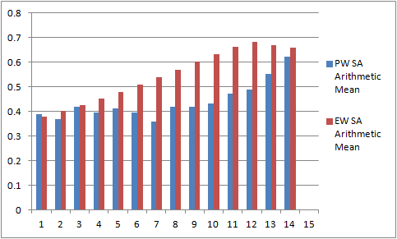
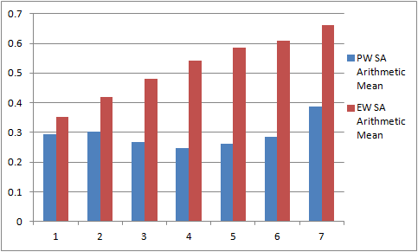
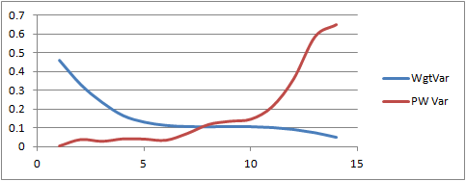
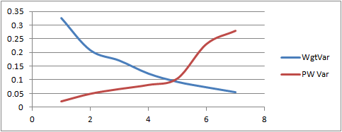
12.EBBP 13. Effusive Erupt

Slide 8
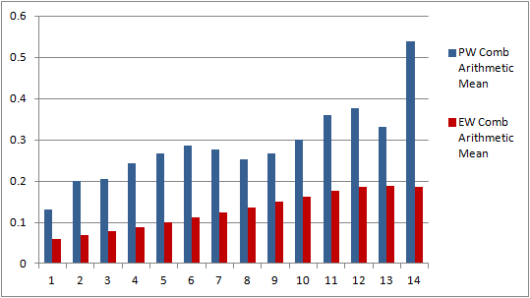
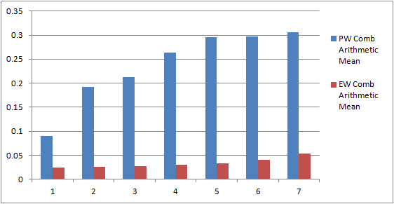
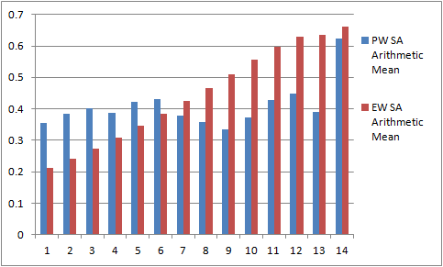
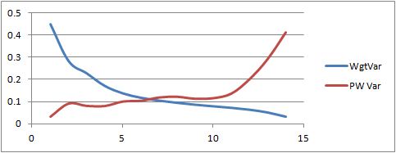
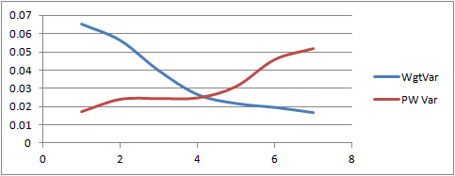
14 Erie Carps 15 FCEP PW=BE

Slide 9
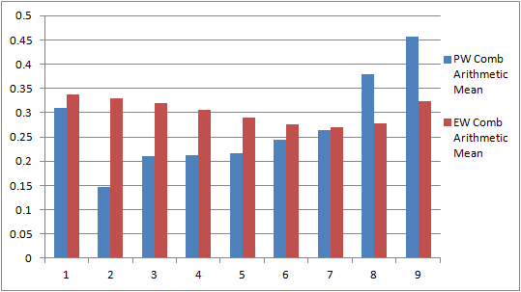
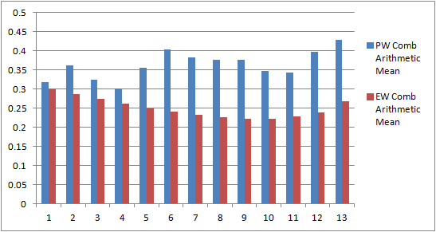
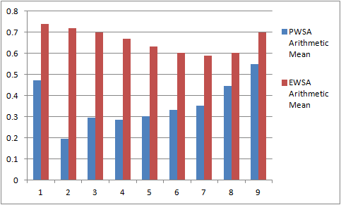
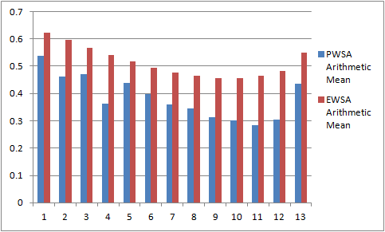
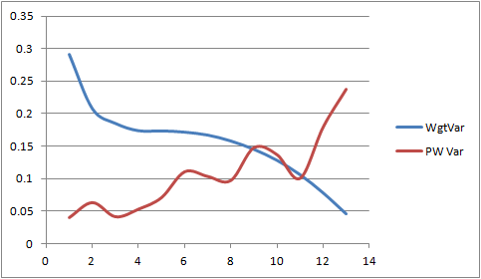
16 Florida 17 Gerstenberger

Slide 10
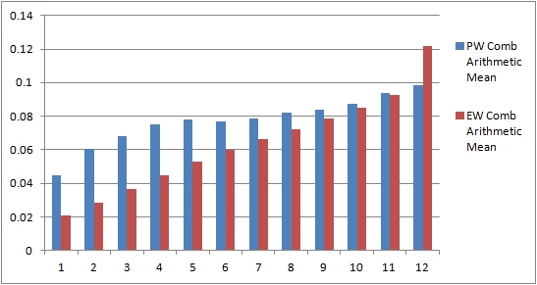





18 GL-NIS 19 Goodheart PW=BE

Slide 11






20 Hemophilia 21 Ice Sheets PW=BE
2012

Slide 12






22 Illinois 23 Liander

Slide 13






24 Nebraska PW=BE 25 Obesity PW=BE

Slide 14






26 PHAC _2009_T4 27 San Diego

Slide 15





28 Sheep_Scab PW=BE 29 Speed

Slide 16






30 TDC PW=BE 31 Tobacco PW=BE

Slide 17






32 Topaz PW=BE 33 UMD_Nremoval PW=BE

Slide 18






34 Washington 35 Breast feeding

Slide 19






36 IQ&EARNINGS 37 ARS(USGS)

Slide 20






38 UK-DRIVE AB 39 Spain-DRIVE AB

Slide 21





40 ITALY-DRIVE AB 41 FRANCE-DRIVE AB

Slide 22






42 CDC All 48 43 CDC Panel 6

Slide 23





44 Oswaldo GDP 45 Oswaldo OilPrices

Slide 24






46 Brexit 47 Tadini Quito

Slide 25



48 Tadini Clermont
NB the study Political Violence had too many calibration vbls for the cross validation code. 49 studies were tallied in the Int’l J Forecasting (2019)article, but only with 80% of calibration vbls. This aticle also treats the Random Expert Hypothesis.
The best source for the cross validation is the RESS 2017 article, although that uses the 33 then completed studies.

Slide 26


Results Random Expert Hypothesis. On the vertical axes are the number of studies in which the six performance metrics of the original exceeds the percentile of the respective REH distributions given on the horizontal axes. P-values for selected excedences are shown.

Slide 27
42 of 49, PW combined score > EW Combined score out of sample (80% of calibration vbls in DM)
NB the study Political Violence had too many calibration vbls for the cross validation code. 49 studies were tallied in the Int’l J Forecasting (2019) article, but only with 80% of calibration vbls. This article also treats the Random Expert Hypothesis.
The best source for the cross validation is the RESS 2017 article, although that uses the 33 then completed studies.
Older results, Eggstaff et al 2012
Colson and Cooke 2017, 2018, Cooke et al 2019

Slide 28

Out of Sample Cross-Validation: of Classical Model
62 studies, per study: geomeans of comparisons of PW/EW combined score ratios. Eggstaff, Mazzuchi, Sarkani (2013 RESS);

Slide 29


2019 49 studies

Slide 30
Average over all studies per % training set size of the average PWSa and average EWSa (post 2006)

Slide 31
Average over all studies per % training set size of the average PWInf and average EWInf

Slide 32
Average over all studies per % training set size of the average PWComb and average EWComb
http://www.sciencedirect.com/science/article/pii/S0951832017302090

Slide 33


Geomean of Out-of-sample Validity Index (PW/EW, 80% training)
OoSVI doesn’t predict current DM, but predicts a swarm of DMs related to current DM

Slide 34
References
Colson .A., and Cooke, R.M., (2018) Expert Elicitation: Using the Classical Model to Validate Experts’ Judgments. Review of Environmental Economics and Policy, Volume 12, Issue 1, 1 February 2018, Pages 113–132, https://doi.org/10.1093/reep/rex022 https://academic.oup.com/reep/article/12/1/113/4835830
Colson, A. and Cooke, R.M., (2017) Cross Validation for the Classical Model of Structured Expert Judgment, Reliability Engineering and System Safety, Volume 163, July 2017, Pages 109–120 http://dx.doi.org/10.1016/j.ress.2017.02.003
Eggstaff,J.W., Mazzuchi,T.A. Sarkani, S. (2014) The Effect of the Number of Seed Variables on the Performance of Cooke’s Classical Model, Reliability Engineering and System Safety 121 (2014) 72–82. DOI: 10.1016/j.ress.2013.07.015
Cooke, Roger M., Marti, Deniz and Mazzuchi, Thomas A., (2020) Expert Forecasting with and without Uncertainty Quantification and Weighting: What Do the Data Say? International Journal of Forecasting, published online July 25 2020 https://doi.org/10.1016/j.ijforecast.2020.06.007

